Slide 1
Battle! Vs. Red
A dive into the evolution of Pokémon Trainer Red’s Theme with Jaleel Taylor

Slide 2
Audience
Target Audience: You! (Person watching this presentation!)
Don’t need to be a Pokémon master. I’ll walk you through all the information you need.
Some things that may give you a head start on our journey:
Played through ANY Pokémon games
Played through G/S/C, HG/SS or BW2
Playing the post-game of the games above

Slide 3
Purpose
The purpose of my project is to explain the evolution of music on the handheld Nintendo systems, through the platform of Pokémon Trainer Red’s theme.

Slide 4
Ready to begin our journey?

Slide 5
What is Pokémon?
Pokémon is an adventure game where you befriend creatures know as Pocket Monsters (Pokémon for short), train them in battle, beat a certain number of gyms, take on the best trainers in the Elite 4 and become the best trainer in your game! Easy right?

Slide 6
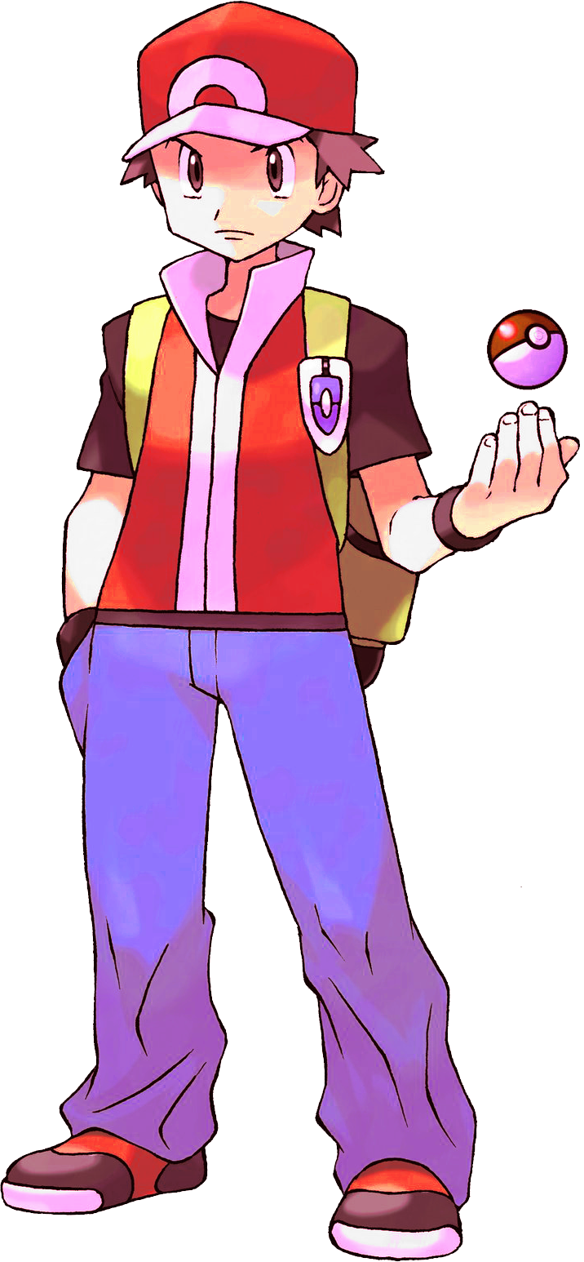
Who is Trainer Red?

Slide 7
Who is Trainer Red?
Pokémon Trainer Red is the main protagonist in Pokémon Red and Green versions (Red and Blue in North America).
Considered the best Pokémon Trainer of all time by most!
The “Final” Final Boss of Pokémon Gold/Silver/Crystal versions (and their remakes Heart Gold and Soul Silver versions).
You only hear his theme vs. the Champion and him.
Yes… He is Ash Ketchum (kind of)…

Slide 8
Pokémon Trainer Red Appearances
Red and Green (Blue) – Main Protagonist
Gold/Silver/Crystal – “Final” Final Boss
Heart Gold/ Soul Silver – “Final” Final Boss
Black 2/ White 2 – Pokémon World Tournament
Sun/Moon/Ultra Sun/ Ultra Moon – Battle Tree

Slide 9
Pokémon Trainer Red Themes
Gold/Silver/Crystal (JP: 1999, NA: 2000)
Heart Gold/ Soul Silver (JP: 2009, NA: 2010)
Black 2/ White 2 (2012)

Slide 10
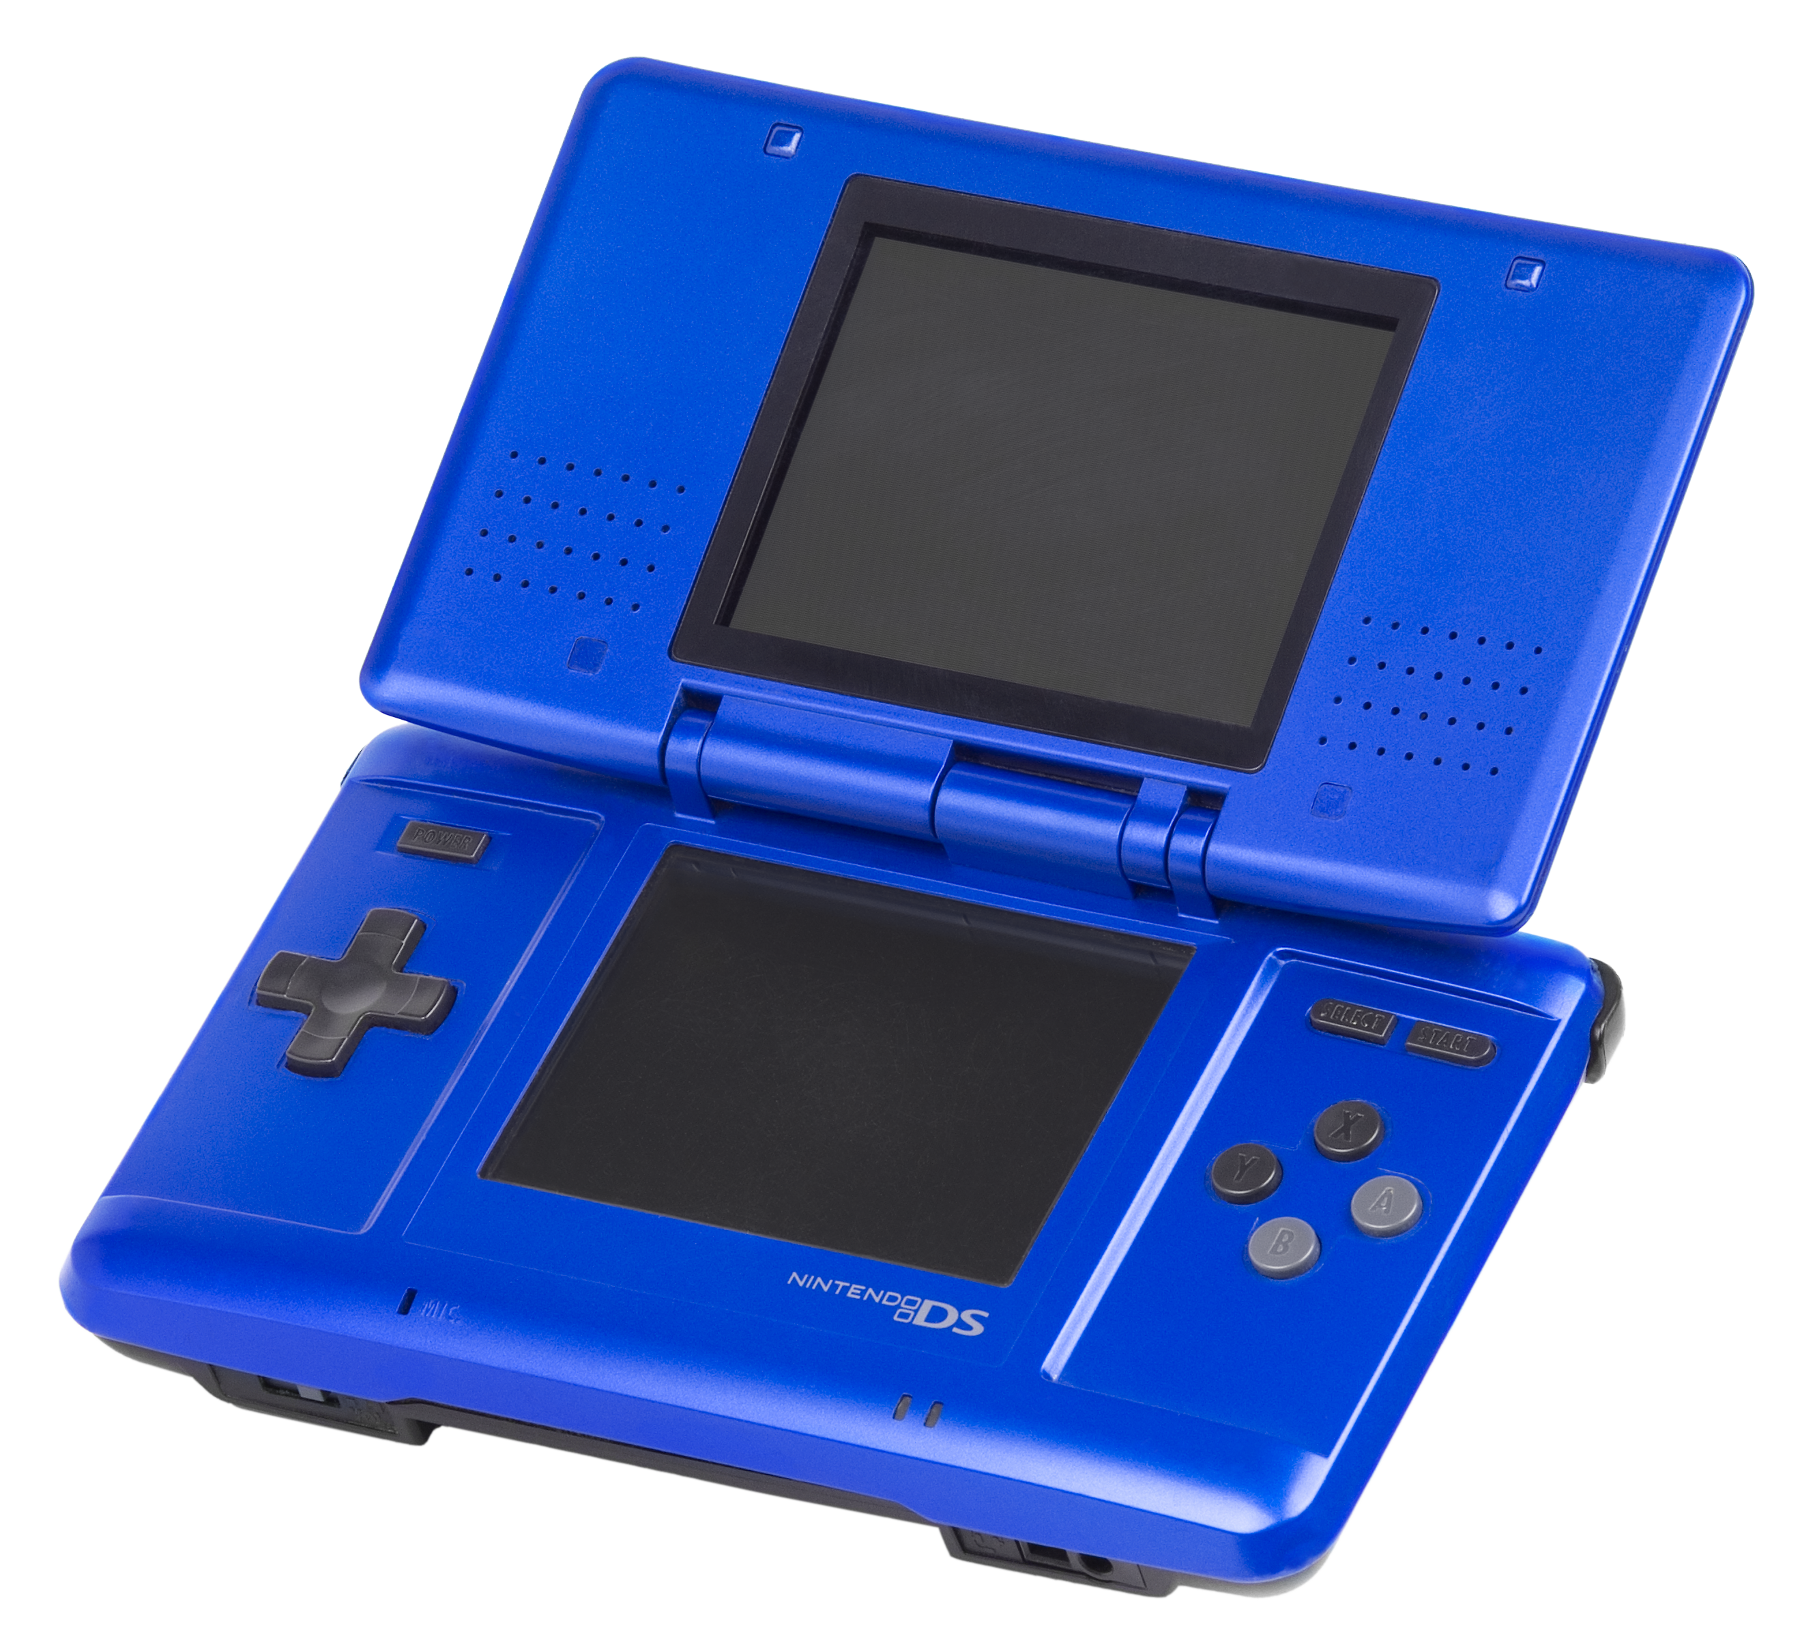
Game Boy Color vs Nintendo DS

Slide 11
Sound on the GBC [1998]
Four Audio Channels
Two are Pulsewave channels, typically used for melodies and occasionally sound effects
A WAV channel, a powerful custom waveform channel which is capable of making much more complex sounds than the Pulsewaves, but has far less volume control
A white noise generator, responsible for a majority of the percussion and sound effects
Only allowed for three sounds to be played at a time

Slide 12
Sound on the Nintendo DS [2004/2010]
Will be comparing the first Nintendo DS as well as the Nintendo 3DS
Both use stereo speakers
First line of handheld devices to not have dedicated sound chips
Sounds depends on program used to make music as opposed to dependence on sound chips
Endless possibilities!
As time goes on, the quality of hardware increases!

Slide 13
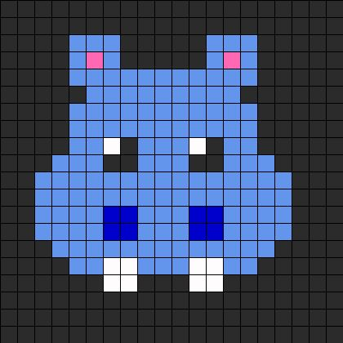
Waveform of GBC and Nintendo DS
Game Boy Color (Top)
Thin Sound
Fuzzy Sound
Nintendo DS (Bottom)
Thicker Sound
Clearer Sound
Closer to a Squarewave

Slide 14
Breakdown of Red’s Theme

Slide 15
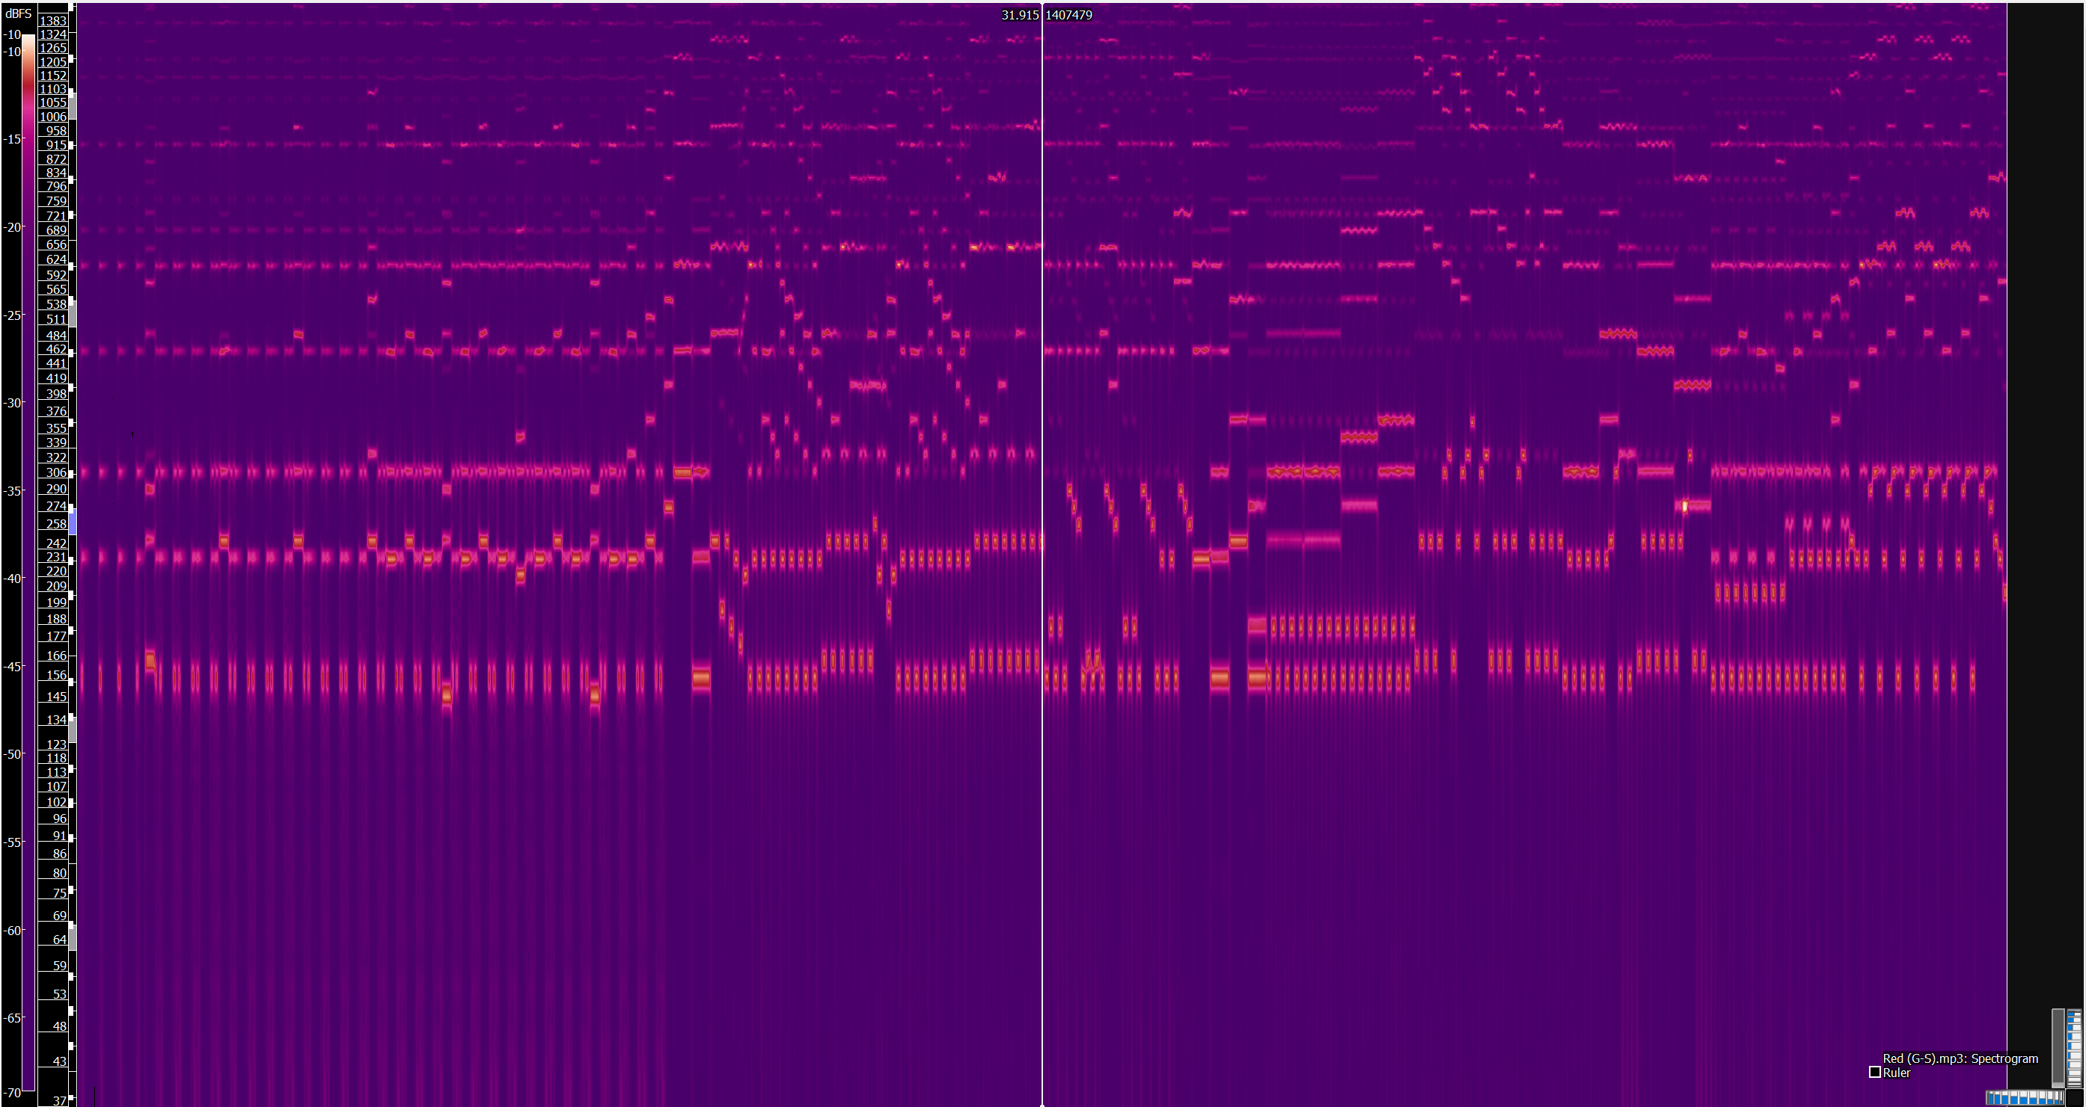
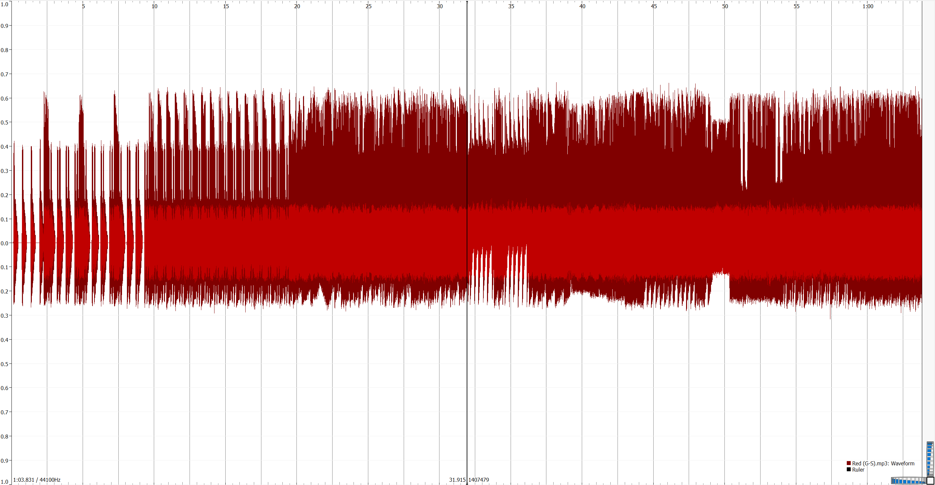
Gold/ Silver/ Crystal Versions

Slide 16
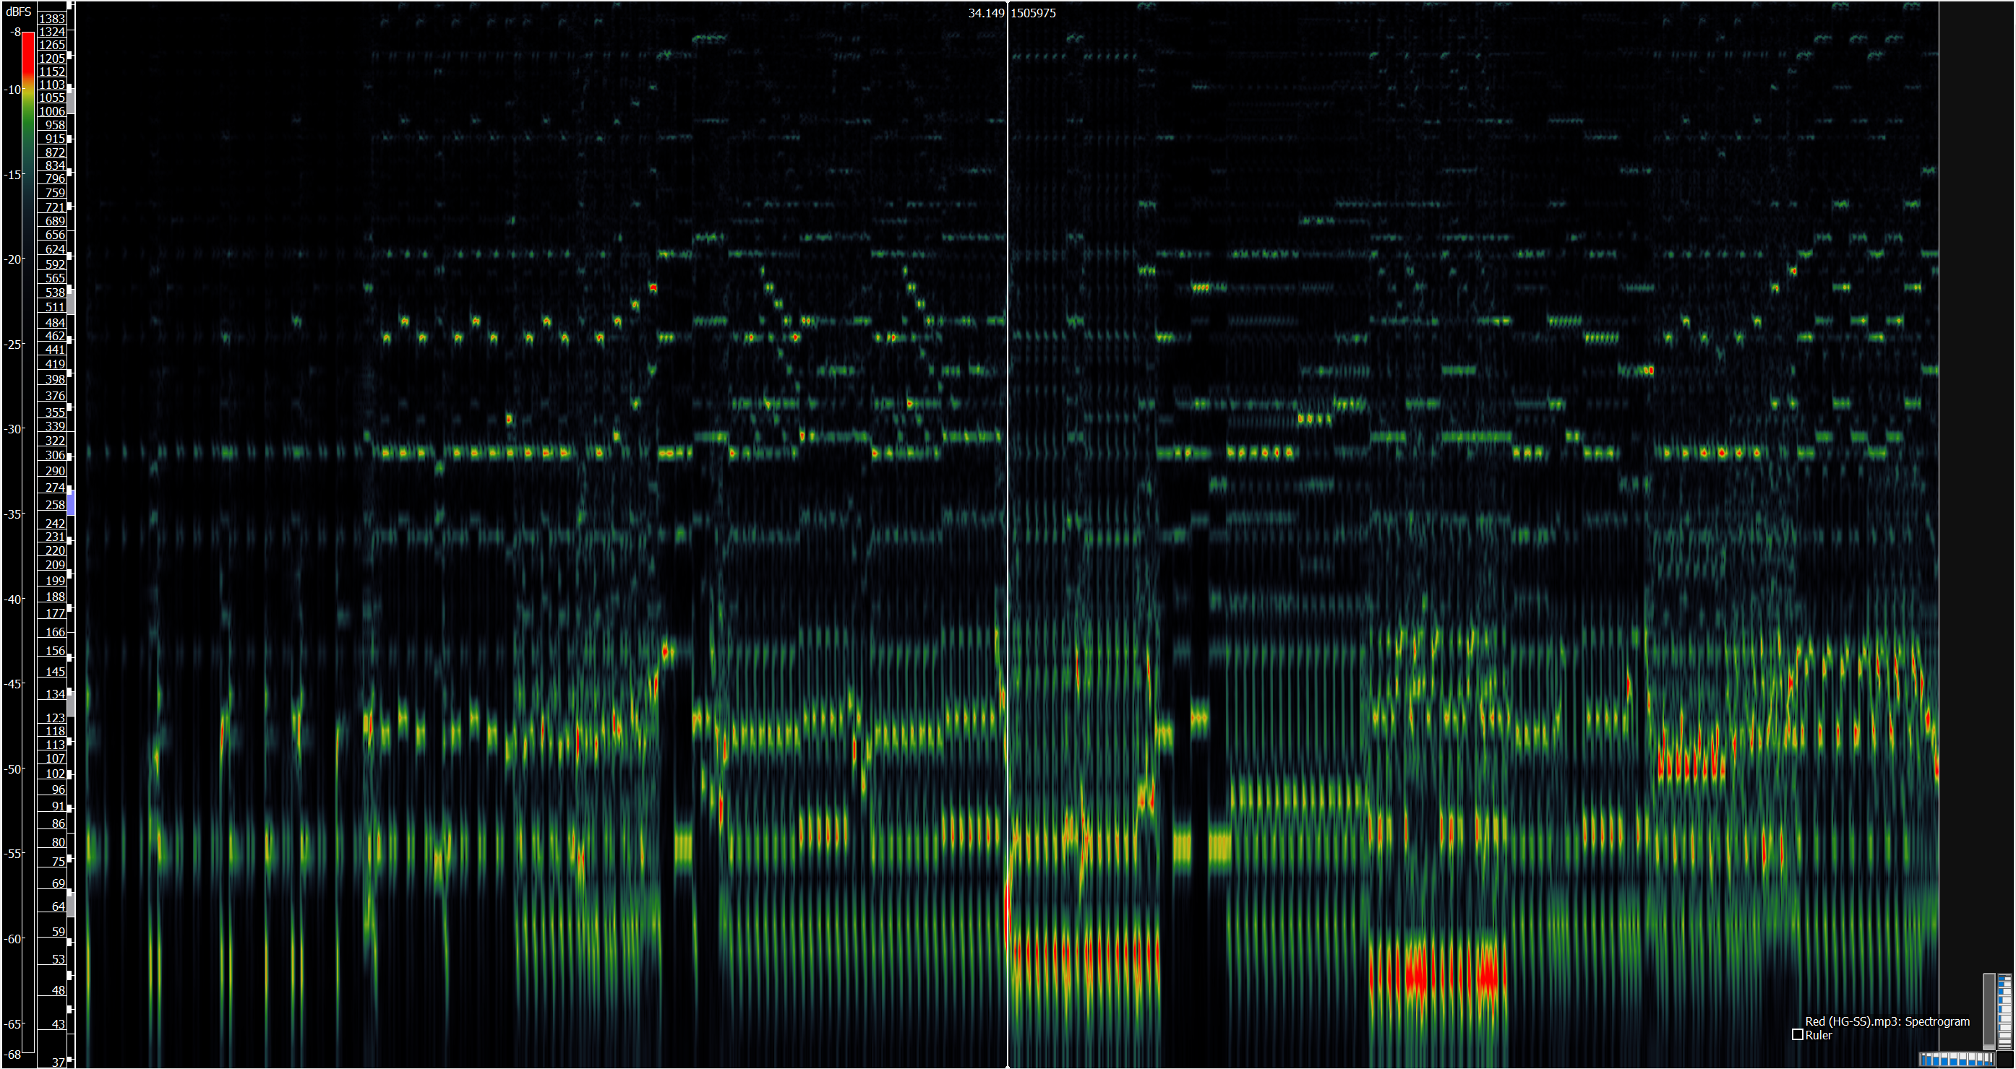
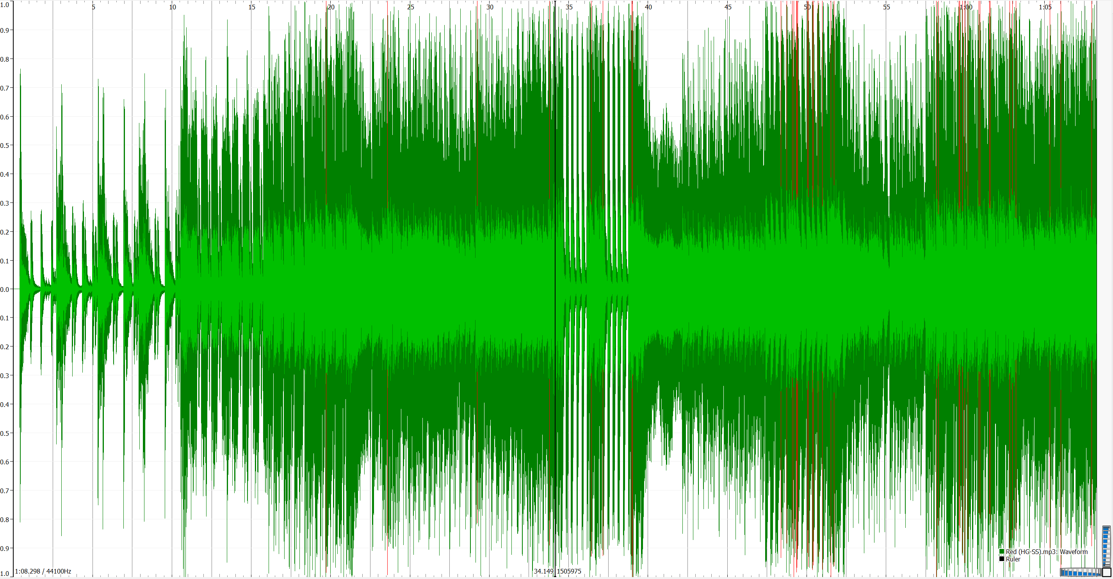
Heart Gold/ Soul Silver Versions

Slide 17
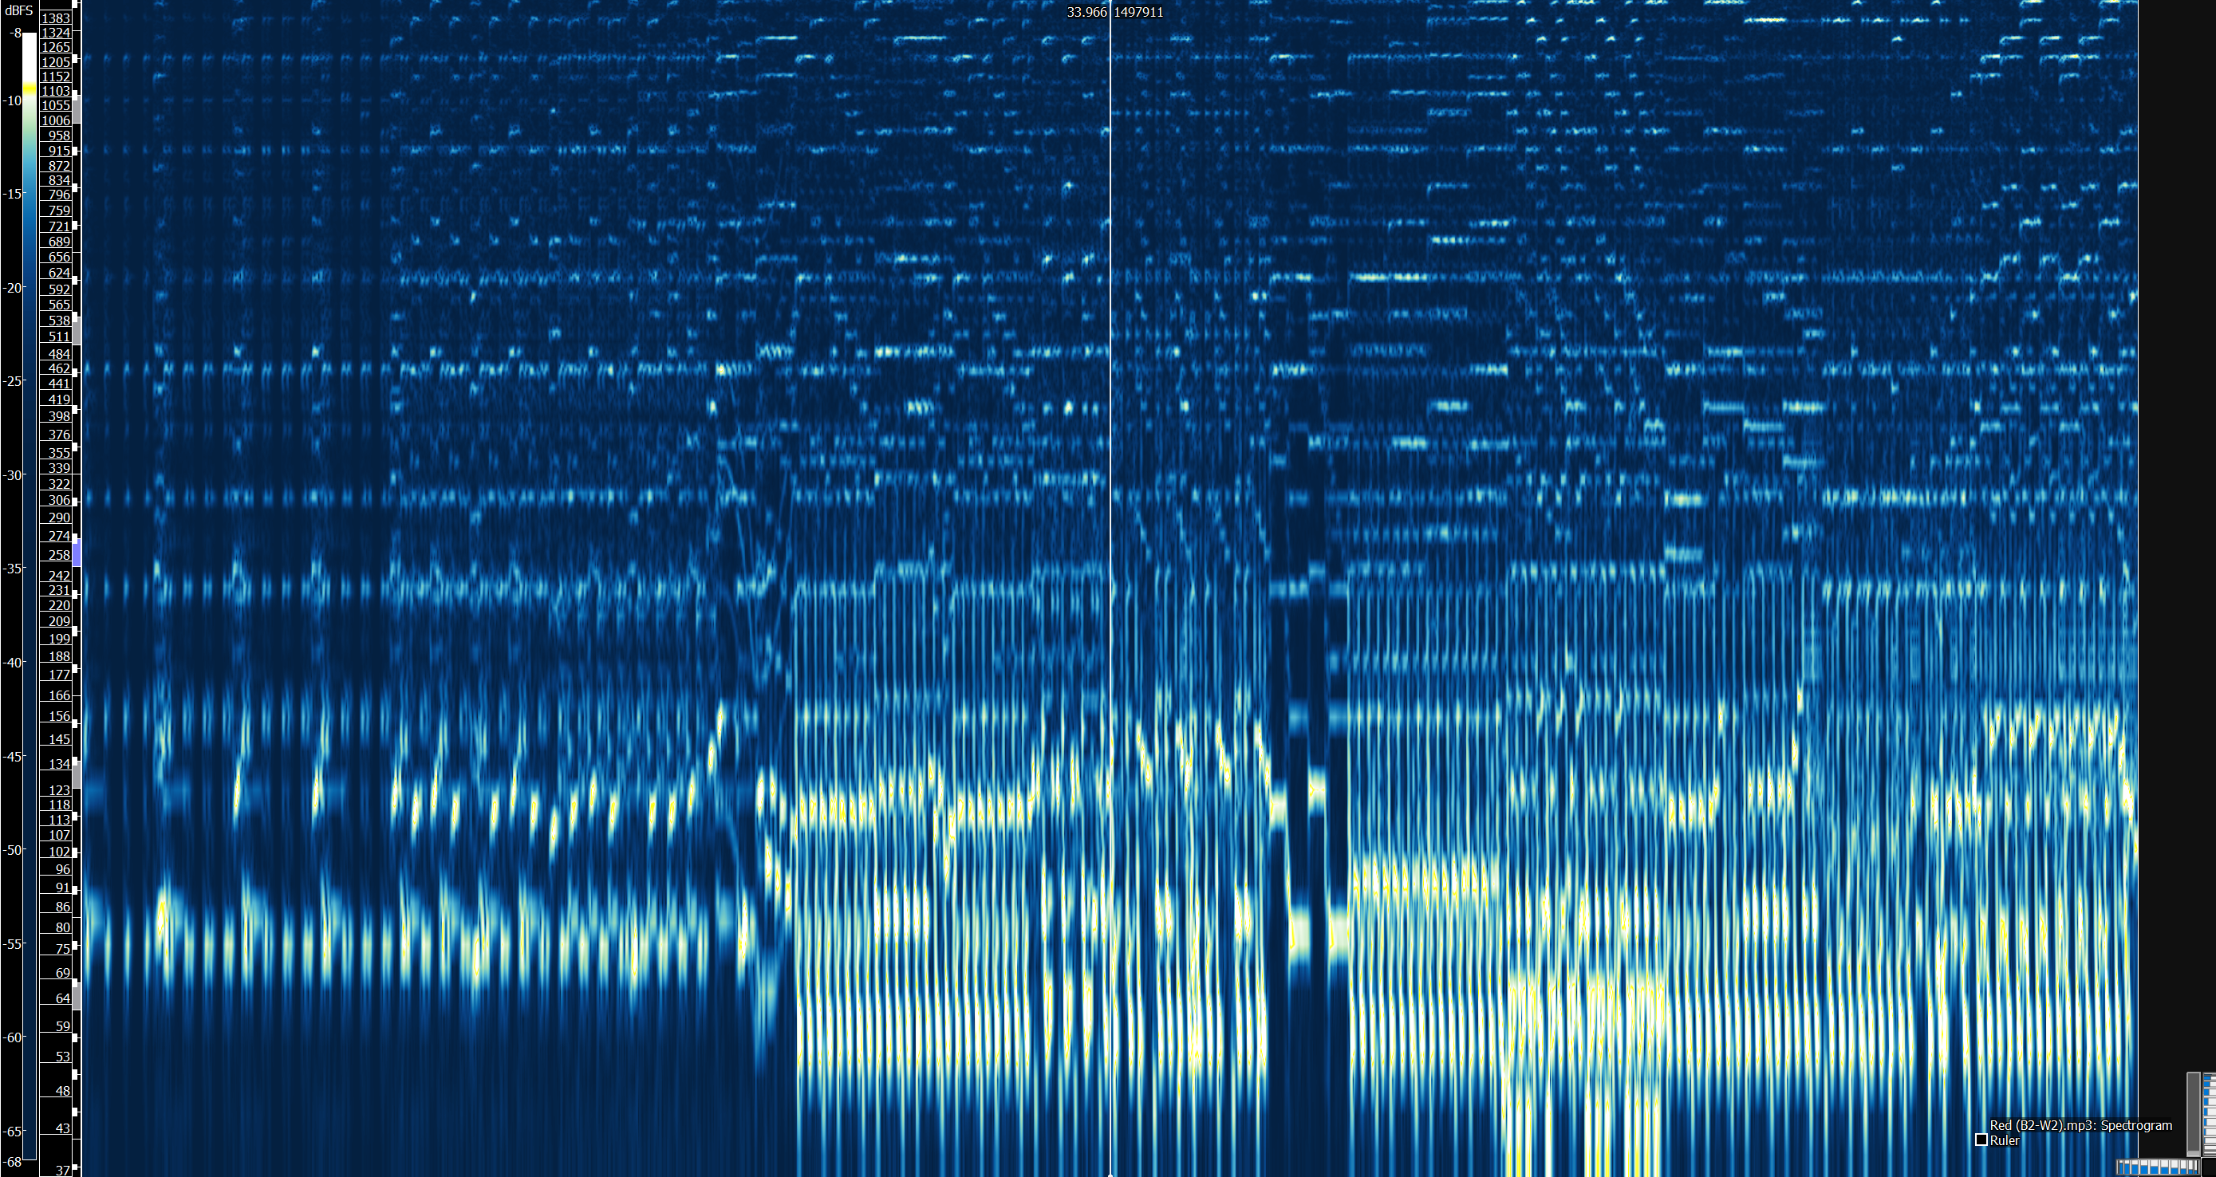
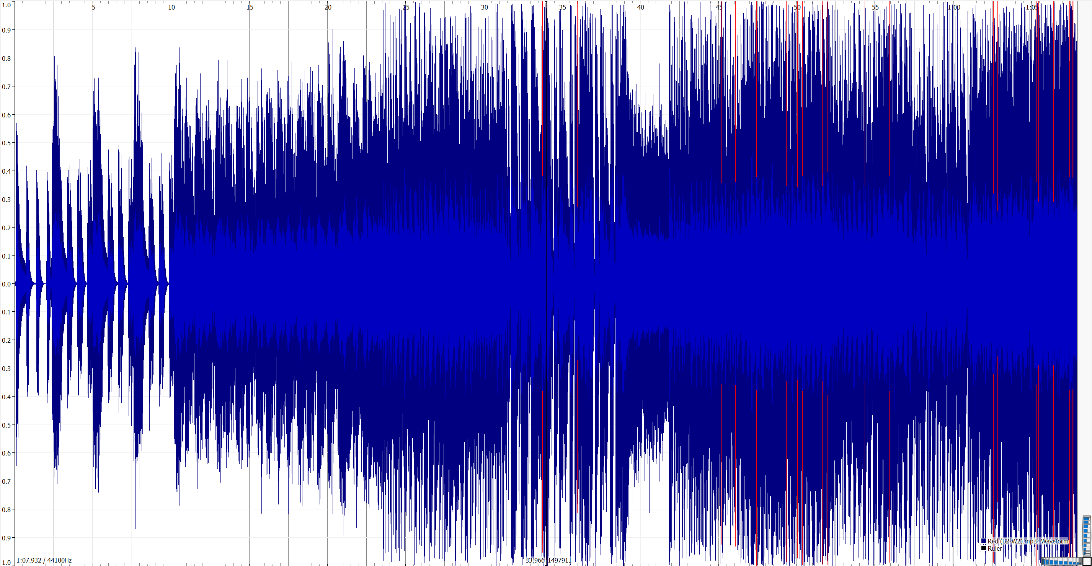
Black 2/ White 2 Versions

Slide 18
Waveform Comparison

Slide 19
Spectrogram Comparison

Slide 20
Questions?

Slide 21
Behind the Scenes (For Dr. Schwarz)

Slide 28
Work Cited
Aquellex. “Game Boy Sound Comparsion (Better than Herbert Weixelbaum's Version) · Tutorials.” Aquellex, aquellex.ws/goodies/tutorial/game-boy-comparison/.
wired. “Classic Video Game Sounds Explained by Experts (1972-1998) | Part 1 | WIRED.” YouTube, YouTube, 12 June 2017, www.youtube.com/watch?v=jlLPbLdHAJ0.
“Game Boy Games That Pushed The Limits of Graphics & Sound.” RetroGaming with Racketboy, 10 Mar. 2018, www.racketboy.com/retro/game-boy-games-that-pushed-the-limits-of-graphics-sound.
“Nintendo 3DS.” Wikipedia, Wikimedia Foundation, 30 May 2018, en.wikipedia.org/wiki/Nintendo_3DS#Hardware.
“Nintendo DS.” Wikipedia, Wikimedia Foundation, 30 May 2018, en.wikipedia.org/wiki/Nintendo_DS.
“Red (Game).” Bulbapedia, the Community-Driven Pokémon Encyclopedia, bulbapedia.bulbagarden.net/wiki/Red_(game)#Pok.C3.A9mon.
Weixelbaum, Herbert. “Game Boy Sound Comparison.” Game Boy Sound Comparison, www.herbertweixelbaum.com/comparison.htm.

